Slide 1

6th Grade Math
Unit 5, Lesson 6 Perimeter on the Coordinate Plane Volume 1, pg. 234

Slide 2


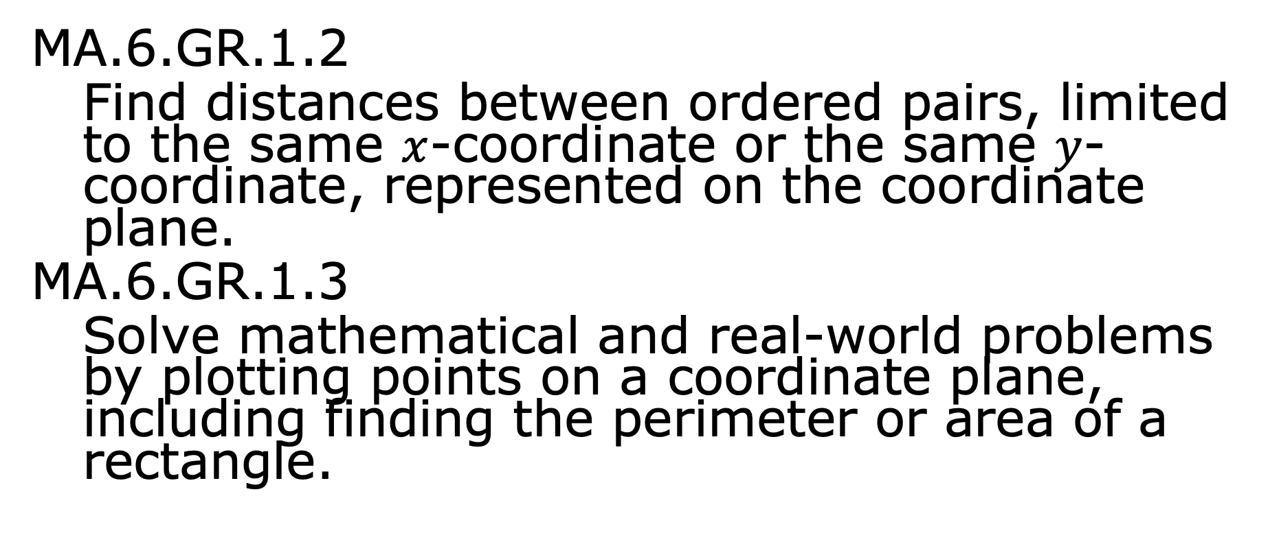
Benchmarks
MA.6.GR.1.2
Find distances between ordered pairs, limited to the same $x$-coordinate or the same $y$-coordinate, represented on the coordinate plane.
MA.6.GR.1.3
Solve mathematical and real-world problems by plotting points on a coordinate plane, including finding the perimeter or area of a rectangle.
volume 1, pg. 234

Slide 3
Integrated Mathematical Thinking and Reasoning Standards
MA.K12.MTR.1.1 Actively participate in effortful learning both individually and collectively.
MA.K12.MTR.4.1 Engage in discussions that reflect on the mathematical thinking of self and others.
MA.K12.MTR.5.1 Use patterns and structure to help understand and connect mathematical concepts.
volume 1, pg. 234

Slide 4

Learning Targets
I can find distances between ordered pairs.
I can find the dimensions of a rectangle on a coordinate plane.
I can find the perimeter of a rectangle on a coordinate plane.
volume 1, pg. 234

Slide 5

Warm-Up
volume 1, pg. 235

Slide 6
5.6.1 Warm-Up: Self-Assessment
Complete each statement to describe your understanding.
how to plot rational number
ordered pairs in all four quadrants.
how to find the perimeter and area
of rectangles.
I know
I need support with
I know
I need support with
volume 1, pg. 235

Slide 7
I know
I need support with
how to find the vertical or horizontal
distance between two ordered pairs that are located in the
same or different quadrants.
volume 1, pg. 235

Slide 8

Guided Instruction
volume 1, pg. 235

Slide 9

5.6.2 Guided Instruction: Dimensions and Perimeters of Rectangles
A rectangle has vertices at the points $A ($ $−4, −5), B (−4, 3), C (3, 3)$, and $D (3, −5)$ as shown.
The distance between points $A$ and $D$ is the length of the rectangle. The length of the rectangle is _________ units.
volume 1, pg. 235

Slide 10
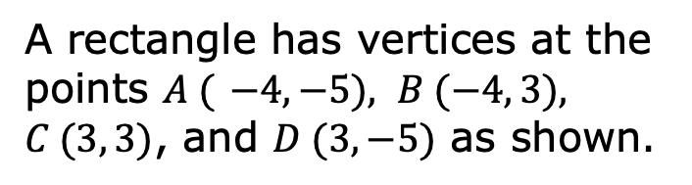
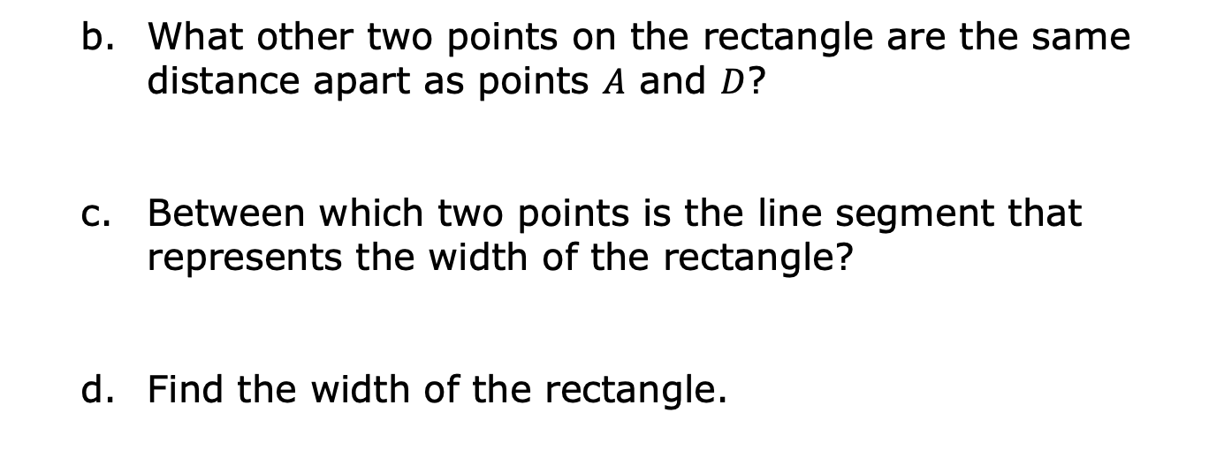
A rectangle has vertices at the points $A ($ $−4, −5), B (−4, 3), C (3, 3)$, and $D (3, −5)$ as shown.
What other two points on the rectangle are the same distance apart as points $A$ and $D$?
Between which two points is the line segment that represents the width of the rectangle?
Find the width of the rectangle.
volume 1, pg. 236

Slide 11

Sonja’s family installed a new pool. Sonja’s dad wants to put up a fence, shown as a blue rectangle, around the pool for safety. The scale of the grid is represented in meters (m). He needs to know how much fencing he will need.
The rectangle that represents the fence has vertices at $A \left(−5, −1\right), B \left(−5, 3\right), C \left(5, 3\right),$and $D (5, −1)$.
volume 1, pg. 236

Slide 12
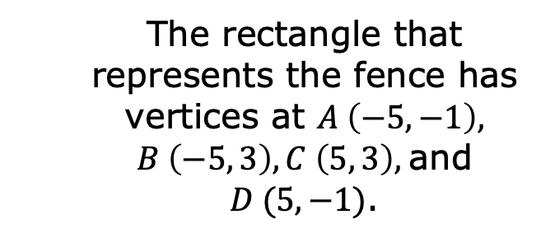
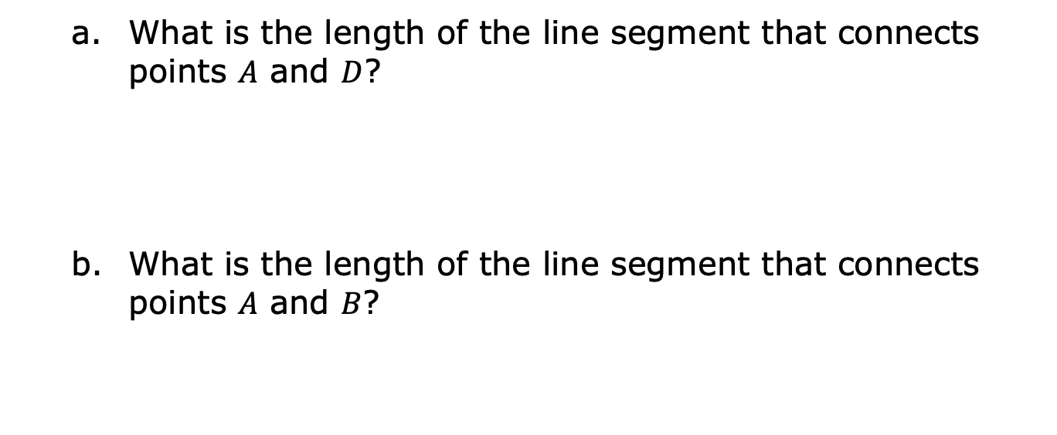
The rectangle that represents the fence has vertices at $A \left(−5, −1\right), B \left(−5, 3\right), C \left(5, 3\right),$and $D (5, −1)$.
What is the length of the line segment that connects points $A$ and $D$?
What is the length of the line segment that connects points $A$ and $B$?
volume 1, pg. 236

Slide 13
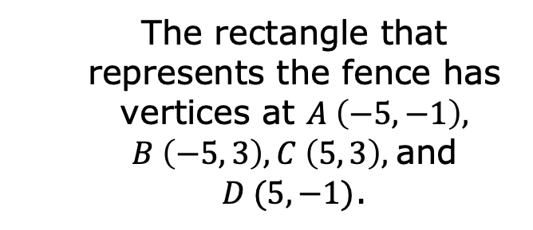
The rectangle that represents the fence has vertices at $A \left(−5, −1\right), B \left(−5, 3\right), C \left(5, 3\right),$and $D (5, −1)$.
Explain how to calculate the perimeter of the fence.
What is the perimeter of the fence in meters?
volume 1, pg. 237

Slide 14

Try It
volume 1, pg. 237

Slide 15

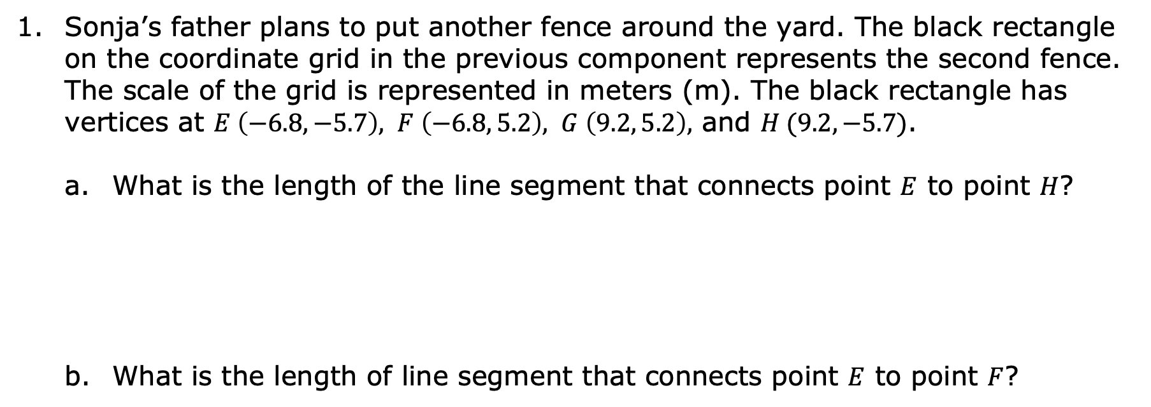
5.6.3 Try It: Perimeter on the Coordinate Plane
Sonja’s father plans to put another fence around the yard. The black rectangle on the coordinate grid in the previous component represents the second fence. The scale of the grid is represented in meters (m). The black rectangle has vertices at $E \left(−6.8, −5.7\right), F \left(−6.8, 5.2\right), G \left(9.2, 5.2\right),$ and $H (9.2, −5.7)$.
What is the length of the line segment that connects point $E$ to point $H$?
What is the length of line segment that connects point $E$ to point $F$?
volume 1, pg. 237

Slide 16
Determine the perimeter of the fence around the yard.
volume 1, pg. 237

Slide 17

Collaboration
volume 1, pg. 238

Slide 18

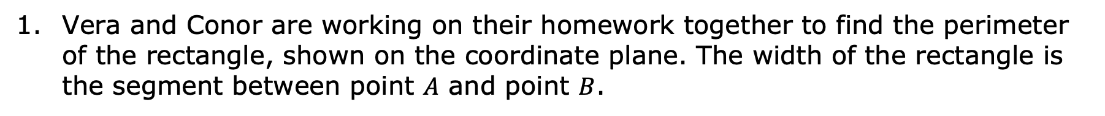
5.6.4 Collaboration: Fix the Mistake
Vera and Conor are working on their homework together to find the perimeter of the rectangle, shown on the coordinate plane. The width of the rectangle is the segment between point $A$ and point $B$.
volume 1, pg. 238

Slide 19
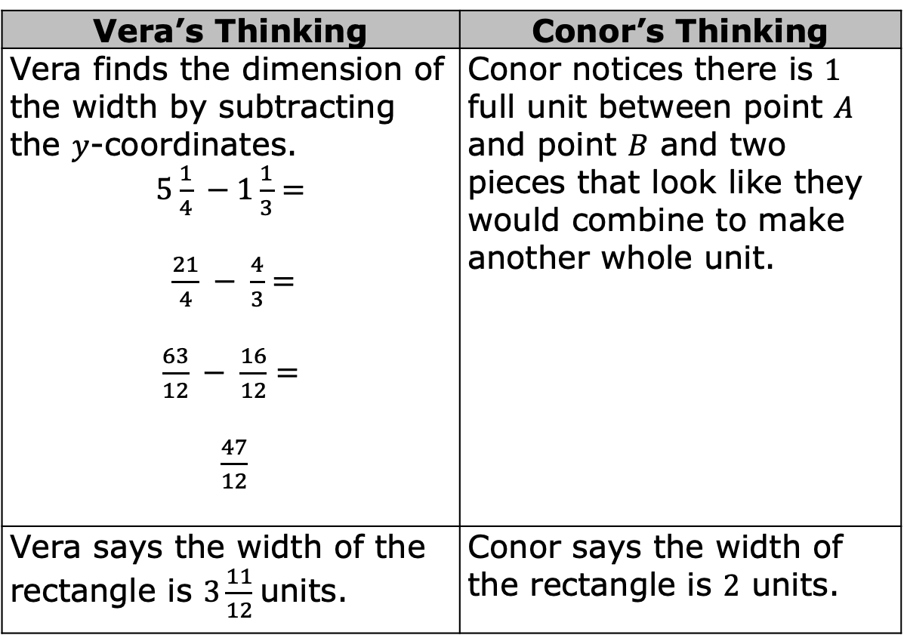
Conor counts the units between the numbers, while Vera determines the dimensions by subtracting. Each student’s work and answers are shown.
Vera’s Thinking | Conor’s Thinking
Vera finds the dimension of the width by subtracting the $y$-coordinates. $5\frac{1}{4} −1\frac{1}{3}=$ $\frac{21}{4} − \frac{4}{3}=$ $\frac{63}{12} − \frac{16}{12}=$ $\frac{47}{12}$ | Conor notices there is $1$ full unit between point $A$ and point $B$ and two pieces that look like they would combine to make another whole unit.
Vera says the width of the rectangle is $3\frac{11}{12}$ units. | Conor says the width of the rectangle is $2$ units.
volume 1, pg. 238

Slide 20
Discuss each student’s work with your partner. Explain any errors that either student made.
volume 1, pg. 238

Slide 21
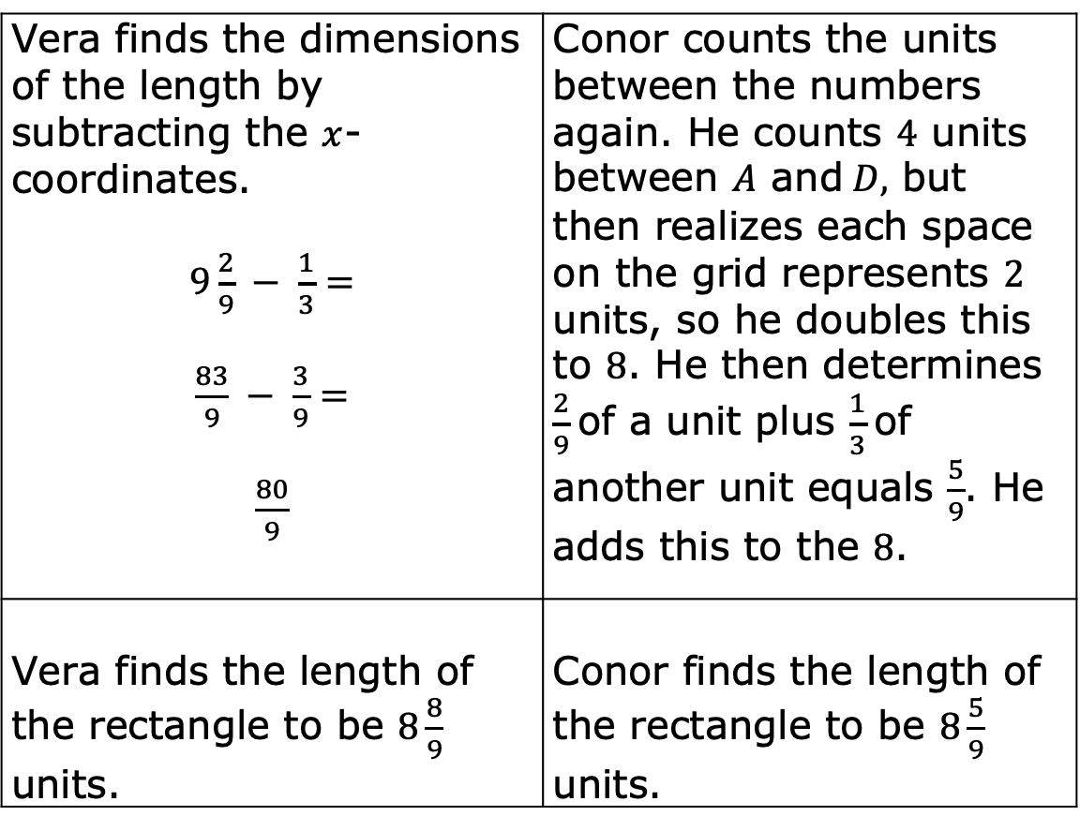
The length of the rectangle is the segment between point $A$ and point $D$.
Vera finds the dimensions of the length by subtracting the $x$-coordinates. $9\frac{2}{9} − \frac{1}{3}=$ $\frac{83}{9} − \frac{3}{9}=$ $\frac{80}{9}$ | Conor counts the units between the numbers again. He counts $4$ units between $A$ and $D,$ but then realizes each space on the grid represents $2$ units, so he doubles this to $8$. He then determines $\frac{2}{9}$ of a unit plus $\frac{1}{3}$ of another unit equals $\frac{5}{9}$. He adds this to the $8$.
Vera finds the length of the rectangle to be $8\frac{8}{9}$ units. | Conor finds the length of the rectangle to be $8\frac{5}{9}$ units.
volume 1, pg. 239

Slide 22
Discuss each student’s work with your partner. Explain any errors that either student made.
After collaborating with each other and understanding their mistakes, Vera and Conor each correctly find the perimeter of the rectangle. What perimeter did they find?
volume 1, pg. 239

Slide 23

Your Turn
volume 1, pg. 239

Slide 24
5.6.5 Your Turn!
The vertices of a rectangle are at points $A (−5, 3)$, $B (3, 3)$, $C (3, −4)$, and $D (−5, −4)$.
What is the length, in units, of the rectangle?
What is the width, in units, of the rectangle?
What is the perimeter, in units, of the rectangle?
volume 1, pg. 239

Slide 25
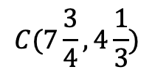
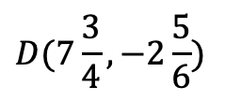
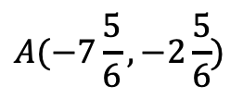
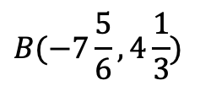
Titus wants to put a border around the outside of his garden.
$$B(−7\frac{5}{6}, 4\frac{1}{3})$$
$$C(7\frac{3}{4}, 4\frac{1}{3})$$
$$A(−7\frac{5}{6}, −2\frac{5}{6})$$
$$D(7\frac{3}{4}, −2\frac{5}{6})$$
If the scale of the grid is in feet (ft), how many feet of border will he need to buy to completely fence in the garden?
volume 1, pg. 240

Slide 26

Wrap-Up
volume 1, pg. 240

Slide 27
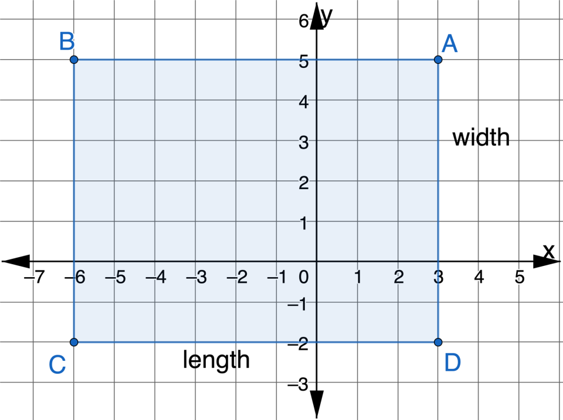
5.6.6 Wrap-Up: Ticket Out the Door
A rectangle is shown on the coordinate plane.
volume 1, pg. 240

Slide 28
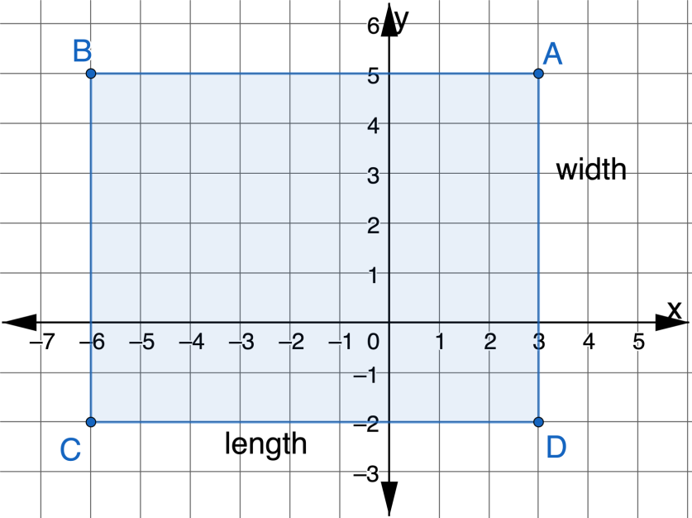
What is the length, in units, of the rectangle?
What is the width, in units, of the rectangle?
What is the perimeter, in units, of the rectangle?
volume 1, pg. 240

